Slide 1
IDENTIFICATION OF RISK GENES FOR NEURODEGENERATIVE DISEASES
National University Of Computer and Emerging Sciences
CS BATCH 2020

Slide 2
Group Members
Robaisha Masood 20k-0390
Noor Afshan 20k-0266
Hira Tahir 20k-0374
Project Supervisor
Shoaib Rauf

Slide 3
ABSTRACT
The purpose of this research is to focus on Alzheimer's disease, which is a neurodegenerative condition often caused due to progressive dysfunction of neurons. Specifically, this study has unraveled Alzheimer's pathology by gaining insights from the dataset GSE118553 from NCBI GEO DATA. These genes form communities that cause malfunctioning. The Dataset contains brain tissue data from 27 control, 33 AsymAD, and 52 Alzheimer subjects. Checked affected areas (entorhinal, temporal, frontal cortex) and spared tissue (cerebellum). Derived meaningful insights from the raw data. Utilizing the advanced data mining method Weighted Gene Co-expression Network (WGCNA) is used to infer the hub genes and their role in such diseases by using pairwise correlation between genes. Furthermore, this study has exploited Machine Learning algorithms to validate our results ensuring accuracy and effectiveness.
Overall our research has uncovered novel genes that may be involved in the pathogenesis of Alzheimer's offering prospects in recognition of AD biomarkers and therapeutic targets. The study discovers the application of Machine Learning algorithms within the domain of bioinformatics. This discovery will facilitate the scientific community to produce more efficacious treatments for neurodegenerative disorders.

Slide 4
Introduction
Neurodegenerative diseases are chronic brain conditions characterized by the gradual degeneration of neurons due to protein misfolding.
These diseases lead to memory loss and behavioral abnormalities.
Notable examples of neurodegenerative diseases include Alzheimer and Parkinson.
In the United States, an estimated six million individuals are afflicted with Alzheimer's Disease, and this number is projected to double by 2050.
Our research aims to uncover protein-to-protein interactions to enable early diagnosis and support drug development for neurodegenerative diseases.
The primary objective of our study is to identify key hub genes that play a vital role in the development of neurodegenerative disorders.
We will utilize graph theory techniques to analyze datasets from the NCBI GEO Database and DisGeNet.
Our methodology involves constructing networks for controlled vs. diseased and applying community algorithms to find similarities between key gene of each network.

Slide 5
Problem Statement
Neurodegenerative diseases are complex conditions characterized by the progressive degeneration of neurons in the brain, leading to a range of debilitating symptoms such as memory loss, cognitive decline, and behavioral abnormalities. Alzheimer's disease and Parkinson's disease are among the most common neurodegenerative disorders affecting millions of individuals.
The burden of neurodegenerative diseases is particularly pronounced given the shift towards an aging population. With increasing life expectancy, these disorders are on the rise, posing significant challenges for healthcare systems and society at large.
Understanding the underlying mechanism driving neurodegenerative diseases is crucial for developing effective treatments and interventions. Recent research has implicated various factors in disease pathogenesis like protein misfolding, and oxidative stress. These molecules contribute to progressive loss of neuronal integrity and function ultimately leading to neurodegeneration.
To address these challenges, approaches combining molecular biology, bioinformatics, and computational biology have emerged as tools for unraveling the complexities of neurodegenerative diseases. By integrating large-scale data and employing advanced techniques researchers aim to find genetic networks and signaling pathways underlying disease progression.
Moreover, finding key genes holds promise for early diagnosis and development of disease-modifying therapies. By computational approaches, researchers can improve the quality of life for individuals affected by neurodegenerative diseases.

Slide 6
LITERATURE REVIEW
Research Item 1 : Dataset
Summary of research
This dataset includes brain samples from control subjects, AsymAD individuals, and Alzheimer's patients. It aligns with the research objective to explore Alzheimer's pathogenesis through gene expression analysis across different stages and brain regions.
Critical analysis
Strengths
Diverse Samples covers various disease stages and brain regions
Raw Data Access allows for in-depth analysis
Weaknesses
Sample Diversity underrepresentation of certain demographics
Data Preparation Needs requires thorough cleaning and standardization
Relationship
Utilizing GSE118553, this study aims to identify crucial genes and pathways involved in Alzheimer's, offering insights for diagnosis and treatment strategies.

Slide 7
LITERATURE REVIEW
Research Item 2 : Normalization
Summary of research
Normalization techniques, including quantile normalization and RMA, for gene expression data. Evaluate different normalization methods to identify the most effective in preserving biological signals.
Critical analysis
Strengths
Comparative Analysis: Offers advantages and limitations of normalization
Preprocessing Emphasis: Highlights the importance of early preprocessing
Weaknesses
Complexity Issues: This leads to variability due to sample preparation and sequencing.
Limited Downstream Analysis: Sparse discussion on the effects of normalization on downstream
Relationship
Normalization and preprocessing are vital for ensuring data accuracy and reliability in gene expression studies. By adopting best practices in data preprocessing, the study intends to provide robust results, mitigate biases, and enhance reproducibility.

Slide 8
LITERATURE REVIEW
Research Item 3 : Downstream Methods
Summary of research
Transition from GRN analysis to WGCNA to study Alzheimer’s disease gene interactions. Shifted to WGCNA to leverage its strengths in identifying co-expressed gene modules significant to Alzheimer’s.
Critical analysis
Strengths
Gene Interaction Insight: Network-based methods provide view of gene interactions
Gene Significance Identification: WGCNA excels at detecting clusters of genes.
Weaknesses
Inconsistency: Variability in gene significance
Validation Needs: Identifying gene clusters
Relationship
Emphasizes the iterative nature of scientific research, adopting methodologies like WGCNA for enhanced insights into Alzheimer’s pathogenesis and intends to harness WGCNA to pinpoint gene clusters associated with Alzheimer’s, advancing the understanding treatment strategies.

Slide 9
LITERATURE REVIEW
Research Item 4: Machine Learning
Summary of research
Employed machine learning techniques, notably Random Forest, to analyze gene expression profiles for Alzheimer’s disease validation.
Critical analysis
Strengths
Precision and Scalability: Accurate predictions and managing large datasets
Complex Relationship Analysis: Capable of identifying non-linear gene interactions
Weaknesses
Interpretability Challenges: It hinders the understanding of underlying disease mechanisms.
Data Dependency: Model performance is heavily dependent on data characteristics
Relationship
Machine learning algorithms are instrumental in dissecting the patterns within neurodegenerative disease datasets. It aims to leverage machine learning to boost the accuracy and reliability of Alzheimer's disease predictions, enhancing our comprehension

Slide 10
Gantt Chart
PROPOSED APPROACH
 | Sep | Oct | Nov | Dec | Jan | Feb | Mar | Apr
1.Study and Research | Task 1 | Task 1
2. Data Collection and Data Preprocessing |  |  | Task 2
3. Construction of GRN |  |  |  | Task 3
4. ML Algorithm Research |  |  |  |  | Task 4
5. Construction of WGCNA |  |  |  |  |  | Task 5 | Task 5
6..Validation of results by ML |  |  |  |  |  |  |  | Task 6

Slide 11
Scope and Limitations
Scope:
Study Objective: Utilize computer analysis to identify genes potentially associated with neurodegenerative diseases.
Focus on Gene Functionality: Emphasis on understanding the functional aspects of these genes.
Ultimate Goal: Improve diagnosis and enhance understanding of the development of neurodegenerative disorders.
Limitations:
Limited Datasets: Use of two to three publicly available datasets from NCBI GEO database and DisGeNet.
Impact of Dataset Quantity: More datasets could potentially enhance accuracy.
Data Quality: Datasets may have limitations, such as data completeness or accuracy.
Reliance on Data Analysis: Conclusions drawn from this study will rely solely on data analysis.
Lack of Experimental Validation: No experimental validation conducted for the study's findings.

Slide 12
Implementation
Data Collection
Data Preprocessing-R
Data Transformation
Weighted Gene Coexpression Network
1
2
Python-based data preprocessing using numpy, pandas, and matplotlib.
Execution in Google Collaboratory or Jupyter Notebook.
Use 2-3 datasets with information on healthy and affected individuals.
Sources: NCBI GEO Data and DisGeNet
3
4
Build protein-to-protein interaction networks.
Utilize WGCNA packages, including cluster profile and Limma.
RStudio will be the primary environment.
Compare controlled vs. diseased networks.
Employ statistical methods ANOVA and Scipy for comparison.
5
Machine Learning
Use ML to assign weights to key genes.
Purpose: Identify the actual disease-associated protein.

Slide 13

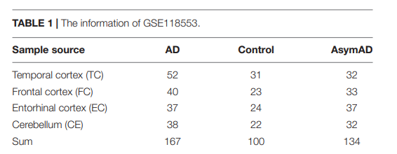
Data Collection
1
Dataset Chosen: GSE118553

Slide 14
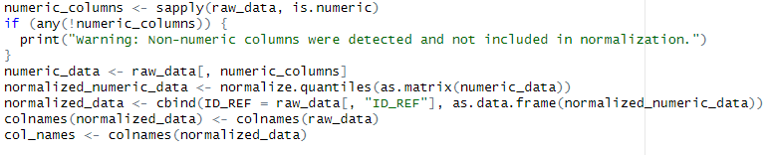
Data PreProcessing
Objective
Method
2
Normalization Of Dataset
Done using RNA
Quantile normalization
Normalize the raw dataframe to remove the variations in dataset

Slide 15
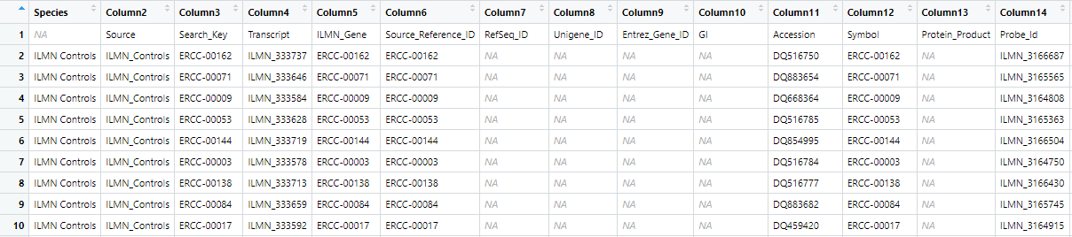
Data Transformation
Extract Insights From Raw Data
First converted raw data into an excel sheet named Book1.xlsx then converted it into dataframe to perform join.
Recognized that Probe_id in df_Book1 is same as ID_REF in our normalized dataframe.

Slide 16
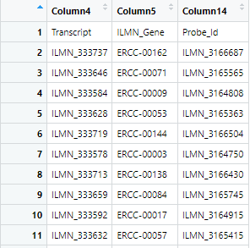
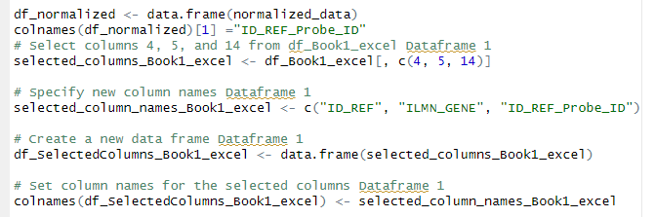
Renaming Columns To Perform Join
Extracted column 4(Transcript),5(ILMN_Gene), and 14(Probe_id) from df_Book1 to perform join with normalized dataframe.
To perform join both dataframe should have common column names.
Named these columns (ID_REF, ILMN_GENE , ID_REF_PROBE_ID).

Slide 17
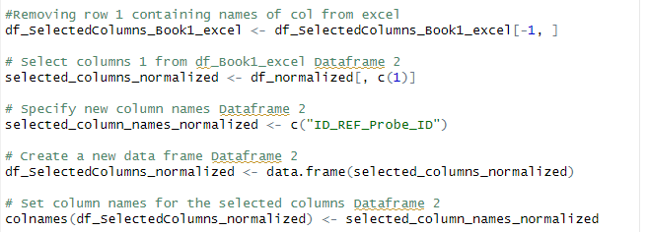
Removing The Row
To perform join row 1 was removed containing old names of columns
Extracted column 1 from normalized data named it ID_RED_PROBE_ID and formed a new dataframe.

Slide 18

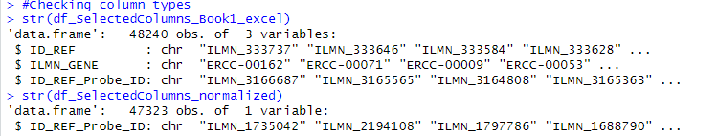
Performing Join
Checking Column Names
Checking Column Types

Slide 19
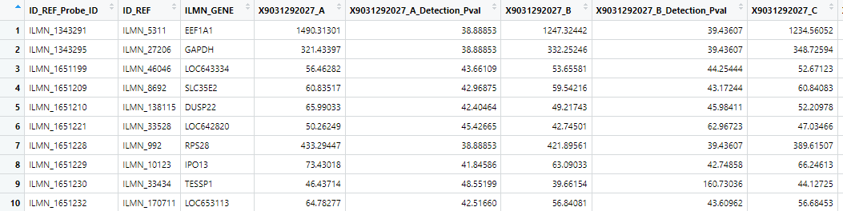
Final Result : View 1

Slide 20
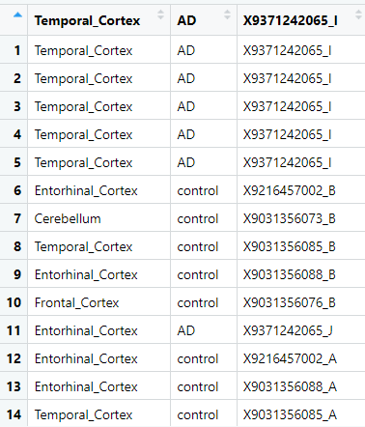
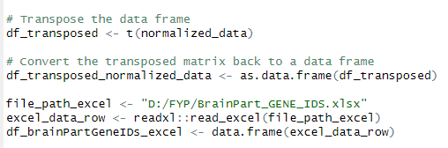
View 2: Brain Parts with respect to ID-REF
Performing Transpose on Normalized Data
Performed Transpose
Converted data into dataframe
Read Brain Parts file from excel

Slide 21
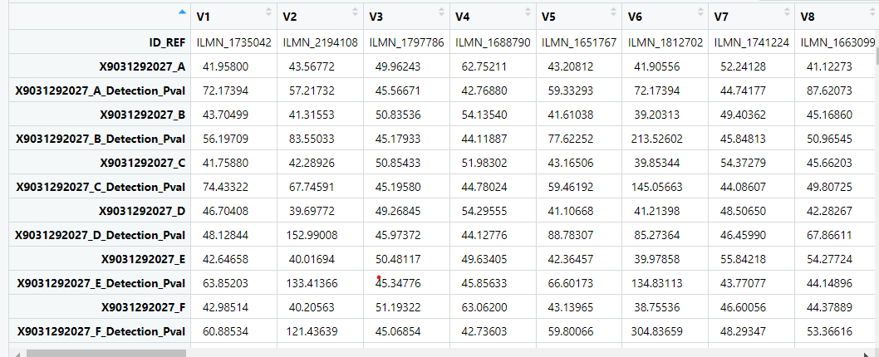
Transposed Data

Slide 22
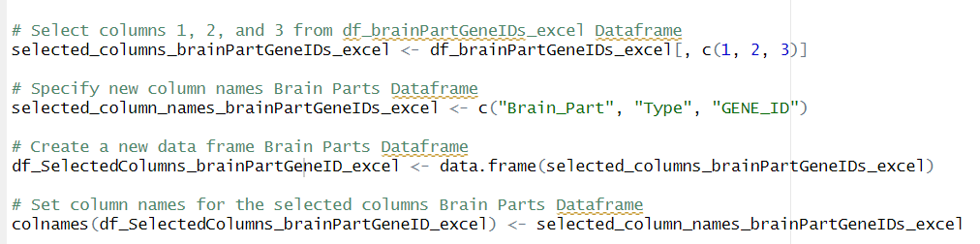
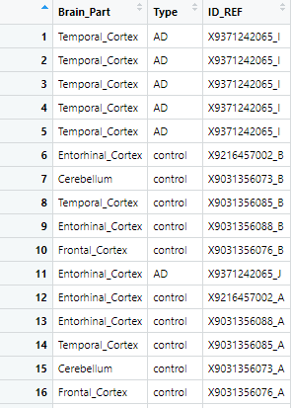
Selected columns from Brain parts dataframe
Specify column names to Brain_Part,Type , and ID-REF
Created a new dataframe
Set Column names

Slide 23
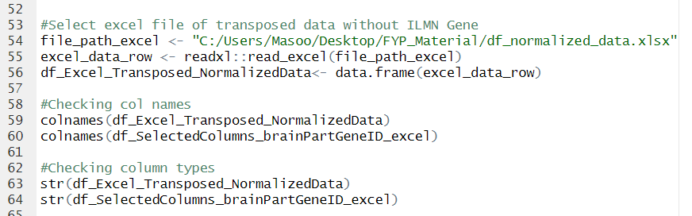
Performing Join

Slide 24
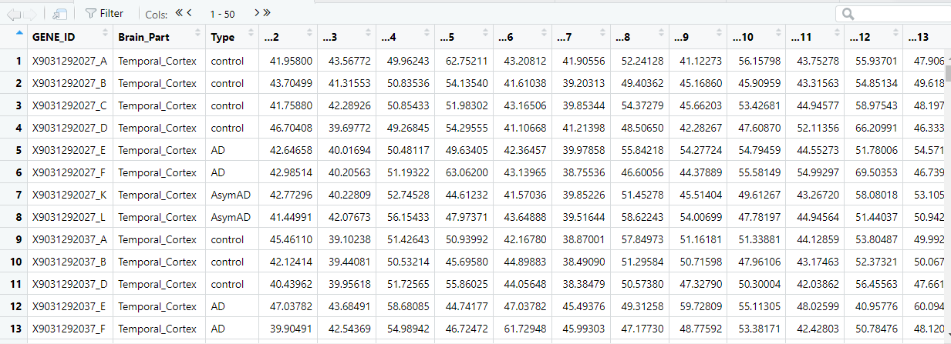
Final Result : View 2
Gene ID , Brain Part ,and Disease state

Slide 25
Network Construction Preparation
Downloading Trrust database
3a

Slide 26
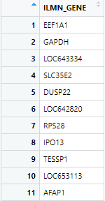
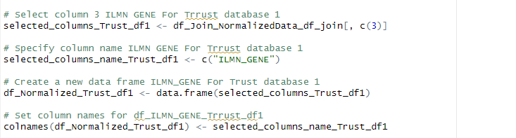
Join on Trust Database with Normalized Data
To perform join we need column columns so first we extracted column 3 ILMN_GENE from our normalized dataset .
Then we put this new column into new dataframe and changed name of column to perform join

Slide 27
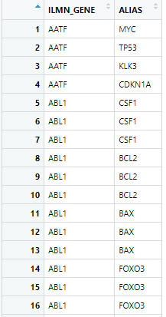
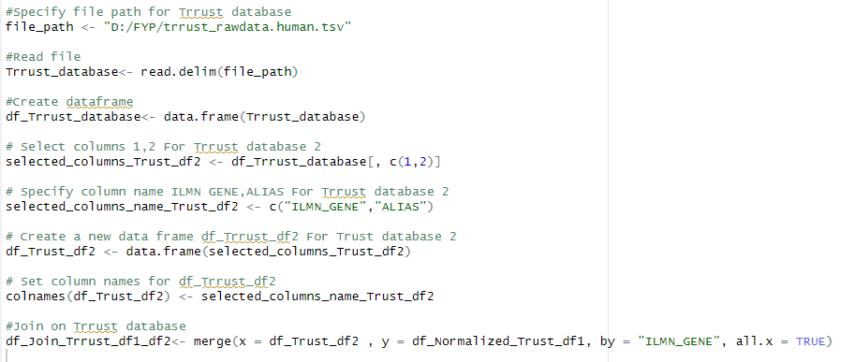
Then we read Trrust database and convert it into dataframe
Extracted Gene names and Its alias from Trrust database to form a network.

Slide 28
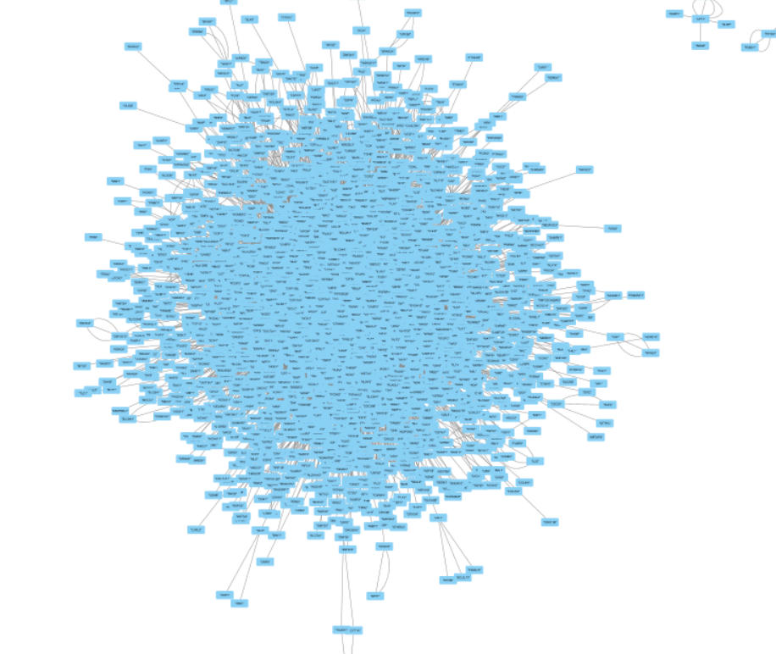
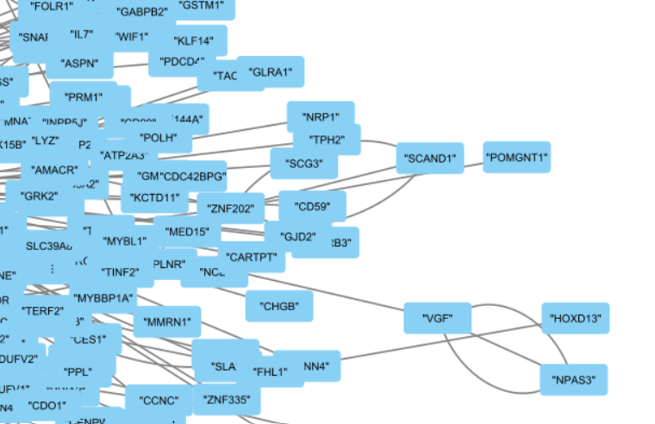
Network Visualization
GRN
A CLOSER LOOK AT NETWORK

Slide 29
Data PreProcessing Python
Importing Libraries
Command Line Arguments
Read Matrix File
Read Family File
Remove Duplicate Probes
Output Matrix and Trait File
Imported necessary libraries such as sys, numpy and pandas.
Get command line argument representing input and output file paths.
A function readMatrixFile is designed to read matrix file line by line. Parse each line to extract ID , expression list , headline , and trait information.In the end it returned a dictionary containing expression data , headline and trait information.
A function names removeDulProbes is used to remove duplicate probes and then an average value for expression values are calculated for each gene.Function iterates over the gene symbol dictionary and expression data.It returns a dictionary mapping gene symbols to expression values.
A function readFamilyFile is used to read data from the family file line by line. Parse each line to extract gene symbol and ID information,Function returned a dictionary mapping IDs to gene symbol
A csv file for information of trait and expression data is made.OutputTraitFile and OutputMatrixFile is generated respectively to write data to output files.

Slide 30
Weighted Gene Coexpression Analysis
Loading Libraries and Data
Preparing Dataset
Detecting Outliers
Preparing Trait Data and Visualizing Clusters
Creating Network
Form clean expression data for network construction by loading the gene expression data and then transposing the data to match WGCNA requirements and removing non-numeric data.
Identify the outliers to prevent skewing the analysis for this dendrogram is generated to inspect outliers groups
Start with preparing the R environment with necessary WGCNA packages like WGCNA, and GO.db and configure R to handle string data and enable multithreading.
Select soft threshold power to use by evaluating scale-free index for key assumption in WGCNA. Then plotting mean connectivity and scale independence plot to visually assess how well different soft-threshold powers confirm to scale-free network. Then construct the network by choosing soft power to create adjacency and then transform it into a Topological Overlay Matrix (TOM) which is used to measure network connectivity of genes reflecting not just correlation but also indirect interaction.
First, import the trait data file and ensure that their sample names and ID matches expression data. Extract and process tissue type information from trait Data and then utilize a color palette to visualize different tissue types in the plot enhancing their interpretability. Generate hierarchical clustering of samples based on their expression profiles and overlay trait data as a color-coded heatmap.

Slide 31
Grouping Genes
Merging Modules
Analyzing Gene Significance
Associating Modules
Merge closely related modules to simplify the network and reduce its complexity. This is done by assessing the dendrogram and merging modules below a certain height threshold which indicates similarity. Then construct gene modules using TOM which helps identify how genes are grouped before or after merging modules
Identify modules based on TOM and analyze the relationship among eigengenes. Perform hierarchical clustering on TOM to group the genes and then apply dynamic tree cut to clustering to define gene modules as it allows to identification of distinct gene clusters. Calculate module eigengenes which are representative gene expression profiles for each module into a single profile to analyze correlated modules.
Prepare data in numerical values for correlation analysis. Calculate the correlation between expression data and module eigengenes to establish gene module membership. Later compute p-values to assess statical significance. Determine the significance of genes concerning tissue type providing an insight into how gene expression relates to phenotype. Later plot the relationship between module membership and gene significance and convert it into a CSV file.
Analyze the relationship between gene modules and phenotype traits to uncover gene expression on specific traits so that after converting categorical values to numerical it is confirmed that trait data and expression data are consistent. Compute correlation and associated p-value between module eigengenes and numerical traits to identify significant relationships. Then generate a heatmap to visually represent the correlation between modules and traits.

Slide 32
Resources Required
Software:
R-studio version 1.4.1106
Python version 3.9.x
Jupyter Notebook/Google Colaboratory
Visual Studio Code
Cytoscape
Hardware:
RAM 64 GB
NVIDIA GeForce RTX 3090
Driver version: 31.0.15.3713
DirectX version: 12 (FL 12.1)
GPU Memory 55.9 GB
Dataset Websites:
NCBI GEO Database GSE118553

Slide 33
PROCESS REQUIREMENTS
Data PreProcessing-R | Affy Tidyverse Openxlsx Dplyr PreprocessCore
Data PreProcessing-Python | Sys Numpy Pandas
WGCNA R-Packages | BiocManager GO.db WGCNA RColorBrewer dynamicTreeCut
Machine Learning | Pandas sklearn.model_selection import train_test_split from sklearn.ensemble import GradientBoostingClassifier from sklearn.impute import SimpleImputer from sklearn.preprocessing import LabelEncoder from sklearn.metrics import accuracy_score, classification_report, f1_score, precision_score, recall_score import xgboost as xgb from sklearn.ensemble import RandomForestClassifier
Libraries Required For Each Process

Slide 34
Validation By Machine Learning
Importing Libraries
Data Preparation
Data Imputation
Model Evaluation
Model Training
The necessary libraries are imported including pandas for data manipulation, Scikit Learn for Machine learning functionalities, and classifiers like GradientBoostingClassifier, xgboost, and RandomForestClassifier.
The features X are separated from the data frame, excluding columns such as identifiers and non-predictive variables. The target variable disease state is encoded using LabelEncoder to convert categorical variables into numerical values. The data is split into training and testing using train_test_split.
Missing Values are imputed using the median value for each column.
Predictions are made on imputed data. The accuracy of each classifier is tested using accuracy_score. The Feature importance is obtained to find important hub genes.
Classifiers are initialized and trained on imputed training data.

Slide 35
Results
Model accuracy and the top 10 hub genes are printed using feature_importance.
Additional evaluation metrics such as F1 score, Precision, and Recall are displayed in the form of classification reports are calculated and displayed.
Table 4. Results Obtained After Machine Learning Algorithms
 | Gradient Boost | XGBoost | RandomForest
Accuracy | 0.8182 | 0.8081 | 0.8184
Precision | 0.8267 | 0.8166 | 0.8179
Recall | 0.8182 | 0.8081 | 0.8182
F1 Score | 0.8169 | 0.8078 | 0.8171

Slide 36
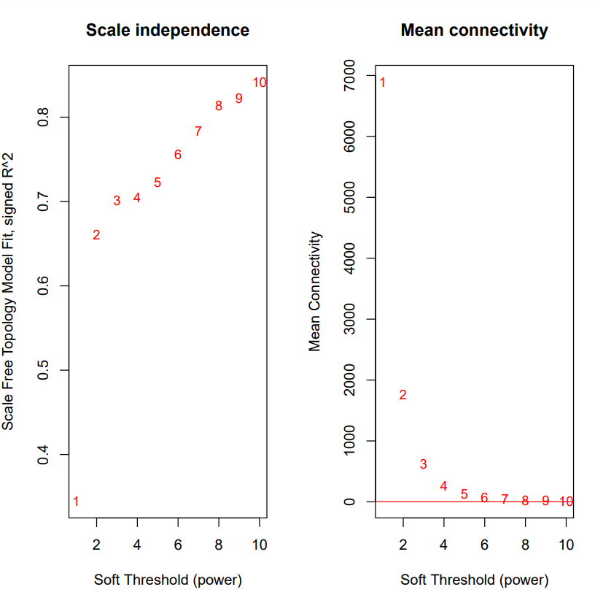
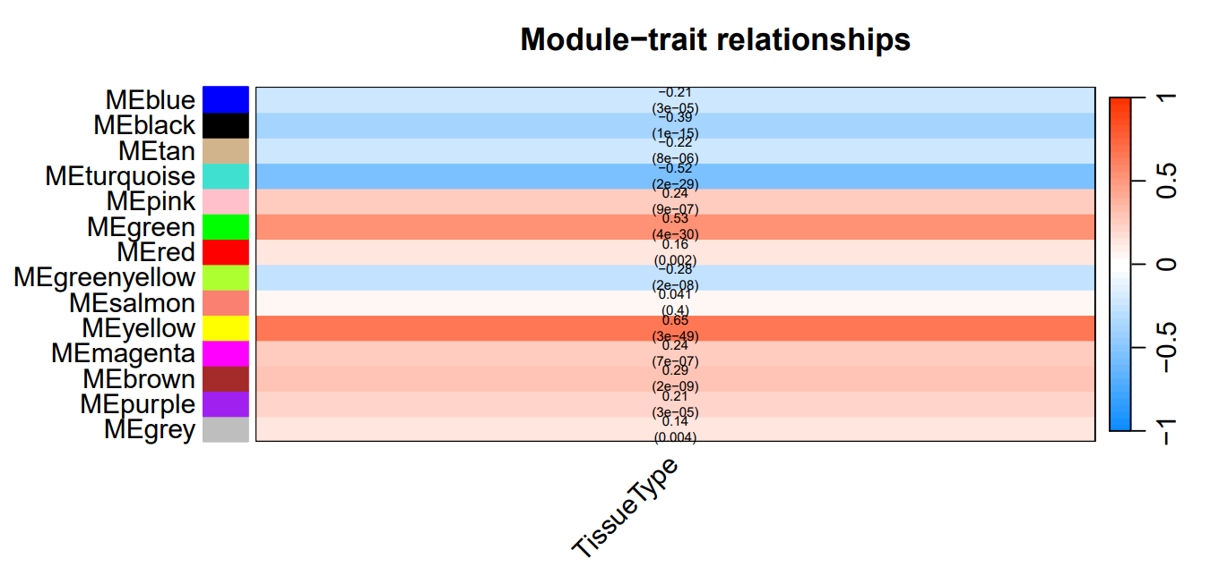
Results Of WGCNA And Discussion
This module-trait heatmap represents the association between identified gene modules and Tissue types. It shows an understanding of how groups of genes correlate with phenotypic traits.
The graph of Network Analysis Outcomes depict how network properties change with different soft threshold powers.

Slide 37
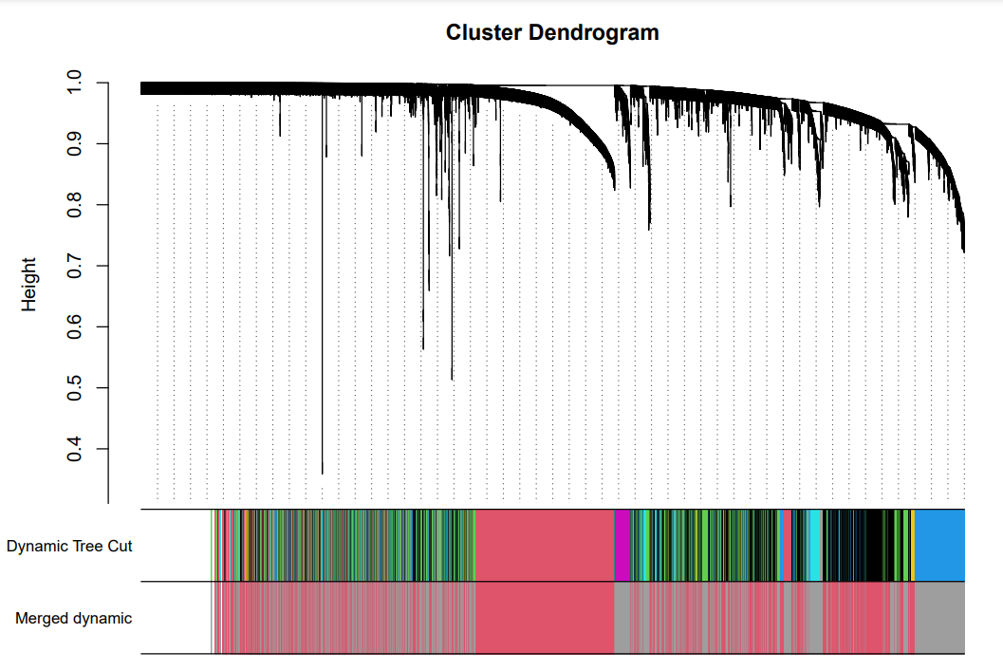
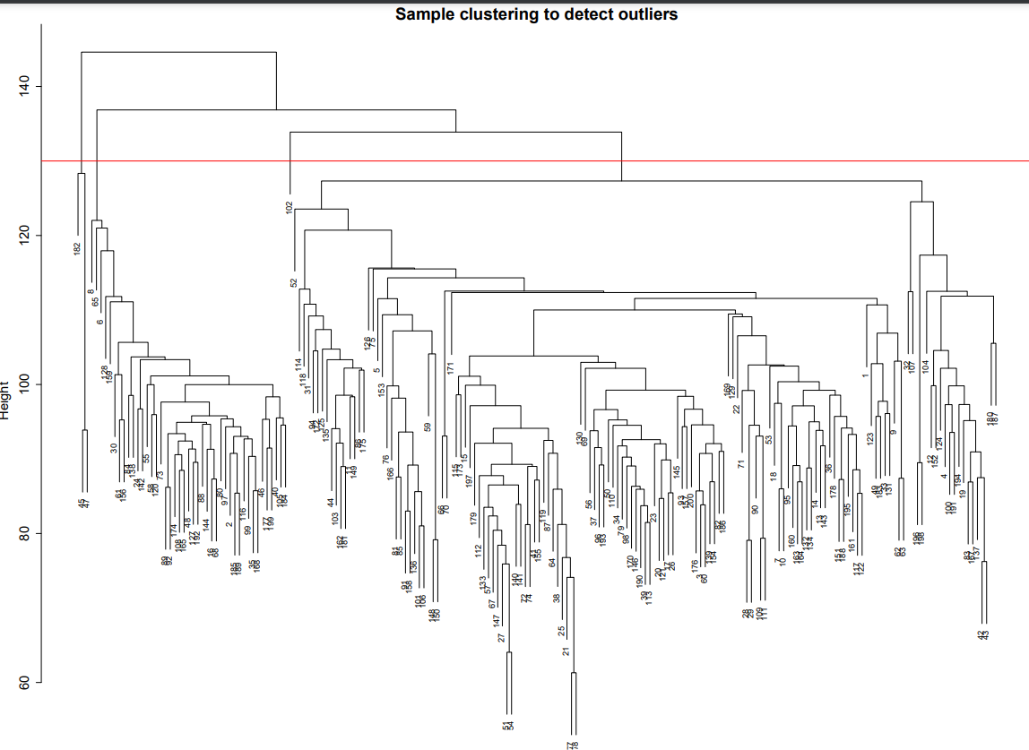
Results And Discussion
The Dendrogram represents clustering of genes based on their expressed pattern which shows similarities
Dynamic Tree Cut in dendrogram identifies distinct modules which are clusters of highly correlated genes
Merged Dynamic indicates results after merging
It is created to detect outliers among samples and it can be due to any reason like experimental errors. This clustering provides insights into relationships and similarities in samples

Slide 38
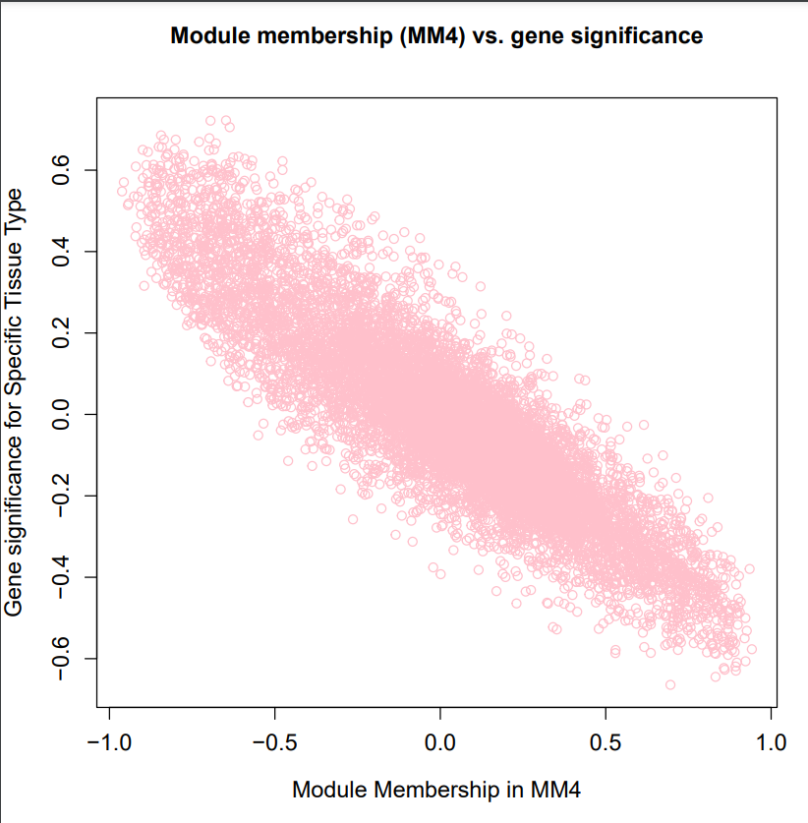
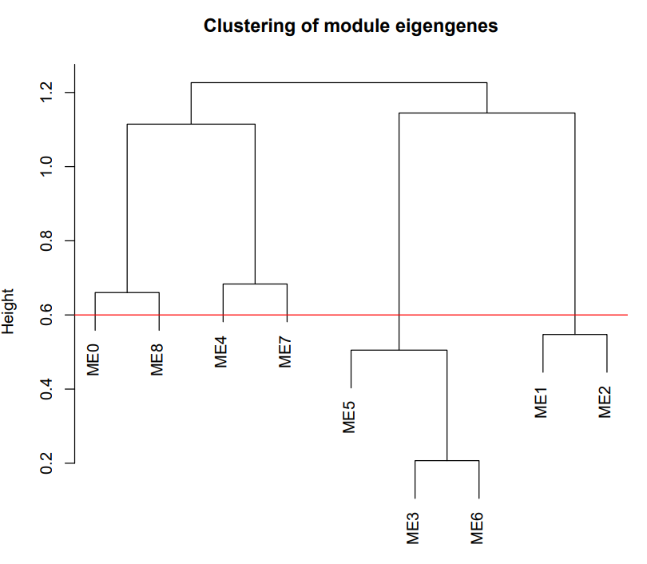
Results And Discussion
Module membership shows genes in specific modules. It quantifies how closely gene expression data is correlated with eigengenes.
Gene significance measures the association between gene expression and Tissue traits.
Eigengenes are used to represent summaries of gene clustering expression patterns. Each label like ME0 represents an eigengenes. It shows similarities between expression profiles.

Slide 39

Conclusion
Significant Contribution: Our project represents substantial efforts in the field of neurodegenerative diseases.
Research Objective: We aimed to identify key genes governing the pathogenesis of these diseases, utilizing diverse datasets from reputable sources.
Advanced Techniques: Leveraging techniques like Weighted Gene Co-expression Network Analysis (WGCNA) and other ML algorithms commonly used in bioinformatics, we addressed complex medical challenges.
Benefit to Scientific Community: Our work contributes to the scientific community by enhancing understanding and offering tools for tackling these diseases effectively.
Promoting Awareness: Beyond expanding molecular knowledge, our project plays a role in raising awareness about these conditions among individuals.

Slide 40
Future Work
Research Papers Contribution: We anticipate producing research papers that will contribute to the research and computational society. Our work will shed light on important causes and genes that play vital roles in neurodegenerative disease development."
Advancement in Genetics: Identification of key genes associated with neurodegenerative diseases contributes significantly to the field of genetics. This knowledge enhances our understanding of the genetic basis of these diseases.
Impact on Welfare and Society: Early Diagnosis Benefits: Our research aims to have a positive impact on welfare and society. Early diagnosis resulting from our work can facilitate timely interventions, as delaying treatment can significantly impact an individual's quality of life.

Slide 41
REFERENCES
[1] Y. Lagisetty et al., “Identification of risk genes for Alzheimer’s disease by gene embedding,” Cell Genomics, vol. 2, no. 9, p. 100162, Sep. 2022, doi: 10.1016/j.xgen.2022.100162.
[2] J. J. Palop, J. Chin, and L. Mucke, “A network dysfunction perspective on neurodegenerative diseases,” Nature, vol. 443, no. 7113, pp. 768–773, Oct. 2006, doi: 10.1038/nature05289.
[3] G. G. Kovacs, “Concepts and classification of neurodegenerative diseases,” in Handbook of Clinical Neurology, 2018, pp. 301–307. doi: 10.1016/b978-0-12-802395-2.00021-3.
[4] M. A. Myszczynska et al., “Applications of machine learning to diagnosis and treatment of neurodegenerative diseases,” Nature Reviews Neurology, vol. 16, no. 8, pp. 440–456, Jul. 2020, doi: 10.1038/s41582-020-0377-8.
[5] W. Mandemakers, V. A. Morais, and B. De Strooper, “A cell biological perspective on mitochondrial dysfunction in Parkinson disease and other neurodegenerative diseases,” Journal of Cell Science, vol. 120, no. 10, pp. 1707–1716, May 2007, doi: 10.1242/jcs.03443.
[6] S. B. Prusiner, “Neurodegenerative diseases and prions,” The New England Journal of Medicine, vol. 344, no. 20, pp. 1516–1526, May 2001, doi: 10.1056/nejm200105173442006.
[7] D. P. Purohit, D. P. Perl, V. Haroutunian, P. Powchik, M. Davidson, and K. L. Davis, “Alzheimer disease and related neurodegenerative diseases in elderly patients with schizophrenia,” Archives of General Psychiatry, vol. 55, no. 3, p. 205, Mar. 1998, doi: 10.1001/archpsyc.55.3.205.
[8] J.-C. Lambert et al., “Meta-analysis of 74,046 individuals identifies 11 new susceptibility loci for Alzheimer’s disease,” Nature Genetics, vol. 45, no. 12, pp. 1452–1458, Oct. 2013, doi: 10.1038/ng.2802.
[9] G. Jun et al., “A novel Alzheimer disease locus located near the gene encoding tau protein,” Molecular Psychiatry, vol. 21, no. 1, pp. 108–117, Mar. 2015, doi: 10.1038/mp.2015.23.

Slide 42
REFERENCES
[10] C. M. Karch, C. Cruchaga, and A. M. Goate, “Alzheimer’s Disease Genetics: From the bench to the clinic,” Neuron, vol. 83, no. 1, pp. 11–26, Jul. 2014, doi: 10.1016/j.neuron.2014.05.041.
[11] J. Hardy and G. A. Higgins, “Alzheimer’s Disease: The Amyloid Cascade hypothesis,” Science, vol. 256, no. 5054, pp. 184–185, Apr. 1992, doi: 10.1126/science.1566067.
[12] V. S. Marde et al., “Neurodegenerative disorders associated with genes of mitochondria,” Future Journal of Pharmaceutical Sciences, vol. 7, no. 1, Mar. 2021, doi: 10.1186/s43094-021-00215-5.
[13] V. Escott-Price et al., “Common polygenic variation enhances risk prediction for Alzheimer’s disease,” Brain, vol. 138, no. 12, pp. 3673–3684, Oct. 2015, doi: 10.1093/brain/awv268.
[14] Guan et al. "Weighted gene coexpression network analysis and machine learning reveal oncogenome associated microbiome plays an important role in tumor immunity and prognosis in pan-cancer." Journal of Translational Medicine 21.537 (2023): 1-21.
[15] Hu, Y., Yu, X., Zhou, Y., Yin, X., Hu, J., Lu, X., & Hu, C. (2020). Identification of novel genes related to Alzheimer's disease pathology using genome-wide co-expression network analysis and supervised machine learning. Frontiers in Aging Neuroscience, 12, 605961. doi: 10.3389/fnagi.2020.605961
[16] S. Balne and A. Elumalai, "Machine learning and deep learning algorithms used for the diagnosis of
Alzheimer's" in Materials Today: Proceedings, vol. 47, no. 15, pp. 5151-5156, 2021, doi: 10.1016/j.matpr.2021.05.499.
[17] P. Kishore, Ch. Usha Kumari, M.N.V.S.S. Kumar, and T. Pavani, "Detection and analysis of Alzheimer’s disease using various machine learning algorithms," in Materials Today: Proceedings, vol. 45, no. 2, pp. 1502-1508, 2021, doi: 10.1016/j.matpr.2020.07.645.
[18] A. Amrutesh, G. B. C G, A. A, A. R. KP and G. S, "Alzheimer's Disease Prediction using Machine
Learning and Transfer Learning Models," 2022 6th International Conference on Computation System and Information Technology for Sustainable Solutions (CSITSS), Bangalore, India, 2022, pp. 1-6, doi:
10.1109/CSITSS57437.2022.10026365.

Slide 43
REFERENCES
[19] Diogo, V.S., Ferreira, H.A., Prata, D. et al. Early diagnosis of Alzheimer’s disease using machine
learning: a multi-diagnostic, generalizable approach. Alz Res Therapy 14, 107 (2022). https://doi.org/10.1186/s13195-022-01047-y
[20] S. Harika, T. Yamini, T. Nagasaki Kamesh, S. H. Basha, S. Santosh Kumar, and Mrs. S. Sri Durga Kameswari, "Alzheimer's Disease Detection Using Different Machine Learning Algorithms,"
*International Journal of Research in Advent Technology (IJRASET)*, DOI: 10.22214/ijraset.2022.46937.
[21] H. Sun, J. Yang, X. Li, Y. Lyu, Z. Xu, H. He, X. Tong, T. Ji, S. Ding, C. Zhou, P. Han, J. Zheng,
"Identification of feature genes and pathways for Alzheimer's disease via WGCNA and LASSO regression," Frontiers in Computational Neuroscience, vol. 16, p. 1001546, Sep. 2022, doi: 10.3389/fncom.2022.1001546.
[22] Langfelder, P., Horvath, S. WGCNA: an R package for weighted correlation network analysis. BMC
Bioinformatics 9, 559 (2008), https://doi.org/10.1186/1471-2105-9-559
[23] Hong Yue, Bo Yang, Fang Yang, Xiao-Li Hu, Fan-Bin Kong, "Co-expression network-based analysis of hippocampal expression data associated with Alzheimer's disease using a novel algorithm," *Experimental and Therapeutic Medicine*, vol. 11, no. 5, pp. 1707-1715, 2016.
[24] B. M. Tijms, A. M. Wink, W. de Haan, W. M. van der Flier, C. J. Stam, P. Scheltens, and F. Barkhof,
"Alzheimer's disease: connecting findings from graph theoretical studies of brain networks," Neurobiology of Aging, vol. 34, no. 8, pp. 2023-2036, Aug. 2013. https://doi.org/10.1016/j.neurobiolaging.2013.02.020
[25] Brier, M. R., Thomas, J. B., Fagan, A. M., Hassenstab, J., Holtzman, D. M., Benzinger, T. L., Morris, J. C., & Ances, B. M. (2014). Functional connectivity and graph theory in preclinical Alzheimer's disease.
*NeurobiologyofAging*,35(4),757-768.[https://doi.org/10.1016/j.neurobiolaging.2013.10.081](https://doi.org/10.1016/j.neurobiolaging.2013.10.081)

Slide 44
REFERENCES
[26]Q. Jing, H. Zhang, X. Sun, Y. Xu, S. Cao, Y. Fang, X. Zhao, and C. Li, "A Comprehensive Analysis Identified Hub Genes and Associated Drugs in Alzheimer’s Disease," vol. 2021, Article ID 8893553, 2021, https://doi.org/10.1155/2021/8893553.
[27]C. Zou, L. Su, M. Pan, L. Chen, H. Li, C. Zou, J. Xie, X. Huang, and M. Lu, "Exploration of novel biomarkers in Alzheimer’s disease based on four diagnostic models," Front. Aging Neurosci., vol. 15, p. 1079433, Feb. 16, 2023. [Online]. Available: https://doi.org/10.3389/fnagi.2023.1079433
[28]Zhang, Y., Kiryu, H. Identification of oxidative stress-related genes differentially expressed in Alzheimer’s disease and construction of a hub gene-based diagnostic model. Sci Rep 13, 6817 (2023). https://doi.org/10.1038/s41598-023-34021-1
[29]A. Sharma and P. Dey, "A machine learning approach to unmask novel gene signatures and prediction of Alzheimer's disease within different brain regions," Genomics, vol. 113, no. 4, pp. 1778-1789, 2021, ISSN 0888-7543, https://doi.org/10.1016/j.ygeno.2021.04.028.
[30]Y. Chen, Z. Li, X. Ge, H. Lv, and Z. Geng, "Identification of novel hub genes for Alzheimer’s disease associated with the hippocampus using WGCNA and differential gene analysis," Frontiers in Neuroscience, vol. 18, no. 1359631, Mar. 2024.
[31]H. Sun, J. Yang, X. Li, Y. Lyu, Z. Xu, H. He, X. Tong, T. Ji, S. Ding, C. Zhou, and P. Han, "Identification of feature genes and pathways for Alzheimer's disease via WGCNA and LASSO regression," Frontiers in Computational Neuroscience, vol. 16, p. 1001546, 2022, https://doi.org/10.3389/fncom.2022.1001546
[32]J. W. Liang, Z. Y. Fang, Y. Huang, Z. Y. Liuyang, X. L. Zhang, J. L. Wang, H. Wei, J. Z. Wang, X. C. Wang, J. Zeng, and R. Liu, "Application of weighted gene co-expression network analysis to explore the key genes in Alzheimer’s disease," Journal of Alzheimer's Disease, vol. 65, no. 4, pp. 1353-1364, 2018, DOI: 10.3233/JAD-180400.

Slide 45
REFERENCES
[33]H. Wang, X. Han, and S. Gao, "Identification of potential biomarkers for pathogenesis of Alzheimer’s disease," Hereditas, vol. 158, pp. 1-8, 2021.
[34]J. Li, Y. Zhang, T. Lu, R. Liang, Z. Wu, M. Liu, L. Qin, H. Chen, X. Yan, S. Deng, and J. Zheng, "Identification of diagnostic genes for both Alzheimer’s disease and Metabolic syndrome by the machine learning algorithm," Frontiers in Immunology, vol. 13, p. 1037318, 2022, https://doi.org/10.3389/fimmu.2022.1037318
[35]J. Ren, B. Zhang, D. Wei, and Z. Zhang, "Identification of methylated gene biomarkers in patients with Alzheimer’s disease based on machine learning," BioMed Research International, 2020, https://doi.org/10.1155/2020/8348147
[36]B. Monk, A. Rajkovic, S. Petrus, A. Rajkovic, T. Gaasterland, and R. Malinow, "A machine learning method to identify genetic variants potentially associated with Alzheimer’s disease," Frontiers in Genetics, vol. 12, p. 647436, 2021, https://doi.org/10.3389/fgene.2021.647436
[37]H. Chen, Y. He, J. Ji, and Y. Shi, "A machine learning method for identifying critical interactions between gene pairs in Alzheimer's disease prediction," Frontiers in Neurology, vol. 10, p. 490162, 2019, https://doi.org/10.3389/fneur.2019.01162
[38]H. Alamro, M. A. Thafar, S. Albaradei, T. Gojobori, M. Essack, and X. Gao, "Exploiting machine learning models to identify novel Alzheimer’s disease biomarkers and potential targets," Scientific Reports, vol. 13, no. 1, p. 4979, 2023.
[39]Q. Jing, H. Zhang, X. Sun, Y. Xu, S. Cao, Y. Fang, X. Zhao, and C. Li, "A comprehensive analysis identified hub genes and associated drugs in Alzheimer’s disease," BioMed Research International, 2021, https://doi.org/10.1155/2021/8893553
[40]A. Sharma and P. Dey, "A machine learning approach to unmask novel gene signatures and prediction of Alzheimer's disease within different brain regions," Genomics, vol. 113, no. 4, pp. 1778-1789, 2021, https://doi.org/10.1016/j.ygeno.2021.04.028

Slide 46


THANKS!
Do you have any questions?

